Slide 1
South Lewis Central School District
January Faculty Meeting

Slide 2
Goals:
Promote a Growth Mindset to EVERYONE – Believing We Can All Get Better is the Biggest and Most Important First Step
Instructional Priorities for the Year:
Post and Know your Major Goal or Essential Knowledge you want Students to Master Each Day
Check for Understanding at the End of Lessons to Make Sure Students Have It
Ways we Can Incorporate Technology to Enhance Learning for Students

Slide 3
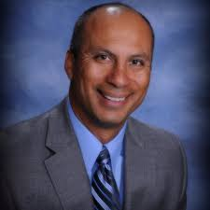
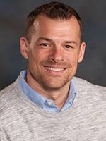
Review from Oct. 10 Supt. Day:
Select a Quote from the Table
Share
Why did you select the quote you did?
What is something you remember about Weston or Jimmy’s presentations that you feel is most important?

Slide 4
Plan for Feb. 13 (Snow Date Feb. 14)
South Lewis Technology Showcase (5-12 Staff and Students)
1st-4th per. classes are canceled at the HS
HS students and teachers circulate to 3 technology sessions that they’ve chosen
6th-10th per. classes are canceled at the MS
MS students and teachers circulate to 3 technology sessions that they’ve chosen
We will be having an assemblies AP to explain the sessions and to review how people will sign up for their sessions
Jan. 29 – Middle School Jan. 31 – High School

Slide 5
John Hattie’s Effect Size:
Weston referenced Hattie’s work, and the classroom strategies that have the largest (and smallest) impact on student learning
Review the hand-outs
With a partner complete the tasks in the Google Doc and be prepared to share
https://docs.google.com/document/d/106YQen0ZmQ4-i0UDkelAKEkQkHj6-COPrfOaNkjmS-8/edit?usp=sharing
Please keep these hand-outs with your plan book, and frequently reflect on your practice – are you increasing the time you use the strategies that have the largest impact??

Slide 6
Goals:
Promote a Growth Mindset to EVERYONE – Believing We Can All Get Better is the Biggest and Most Important First Step
Instructional Priorities for the Year:
Post and Know your Major Goal or Essential Knowledge you want Students to Master Each Day
Check for Understanding at the End of Lessons to Make Sure Students Have It
Ways we Can Incorporate Technology to Enhance Learning for Students

